Slide 1
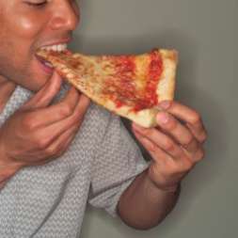
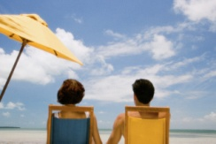
Spring break TIMELINE vacations. activities, APRIL 2014.
MONDAY | TUESDAY | WEDNESDAY | THURSDAY | FRIDAY | SATURDAY | SUNDAY
14th I watched TV with my friends. | 15th I visited the beach. | 16th We played video games. | 17th | 18th | 19th | 20th I ate pizza
21st My sister flew to the beach. | 22nd | 23rd | 24th I slept late. | 25th | 26th | 27th I did my English homework.
Student: YOUR NAME
CBTIS 122. ENGLISH II. Group: [2. N (SMEC), 2.O PROG, 2.Q MCT]
TEAM: ___________

